Slide 1
What is HTML
HTML (HyperText Markup Language) is what webpages are made out of.
We use HTML to describe each part of a webpage is to the browser, so that our content is displayed properly. We help our browsers to understand how we want things displayed by using tags. Here are a few examples of tags that you've probably seen before:
<h1> and </h1>
<p> and </p>
<strong> and </strong>
To create an HTML file, you need to have .html at the end (sort of like how you need .pdf at the end of PDF documents).

Slide 2
The Nuts and Bolts of HTML
When we write HTML, we create HTML Elements by wrapping our content in tags. These tags describe the content that is inside of them, NOT what they look like. We use different kinds of tags to create multiple elements and all together they make up something called our HTML Document.
It is important to understand that HTML has very little to do with the style of your website or the look of the content - that is what CSS is for.

Slide 3
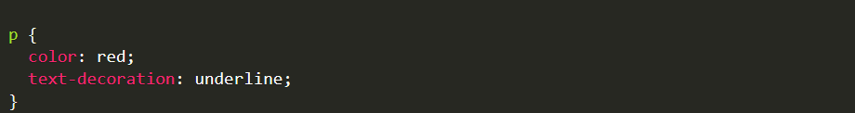
What is CSS?
CSS (Cascading Style Sheets) is what makes websites look nice.
While HTML tells the browser what different parts of the page are, CSS says what those pieces should look like.
For example, p means paragraph in HTML. If we wanted to make all of our paragraphs red and underlined, we'd do something like:

Slide 4
Let's add this to our HTML document
To indicate that we're adding CSS to blank.html, we need to find the opening and closing <style> tags between our opening and closing <head> tags.
<!doctype html>
<head>
<title>Ladies Learning Code HTML and CSS</title>
<style>
p {
color: red;
text-decoration: underline;
}
</style>
</head>
<body>
<p>This is a paragraph</p>
</body>
</html>

Slide 5
A note about HTML and CSS...
HTML and CSS are sort of like languages, but they're DIFFERENT languages. Just like French or Italian, they each have their own set of rules. It takes time to learn these languages. Don't worry if you don't get it all right away.

Slide 6


Slide 7
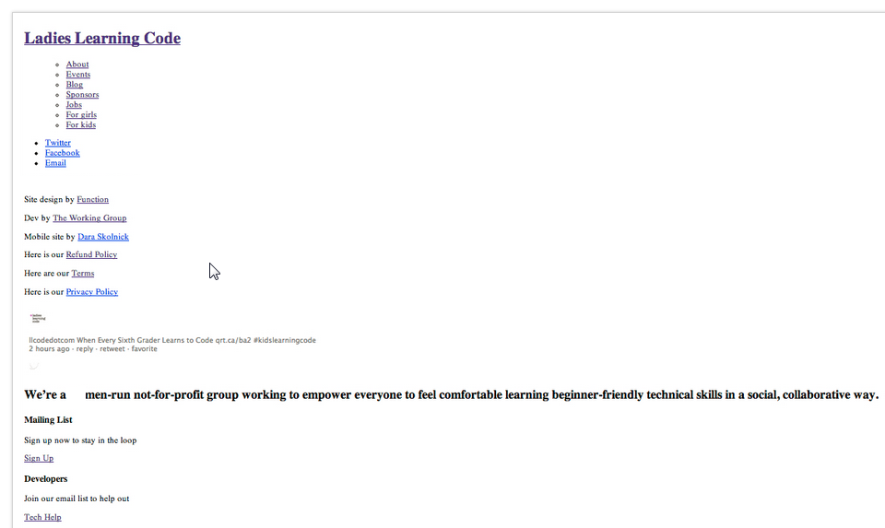

Slide 8
Why is that again?
Because HTML defines content, and CSS defines the look and layout (it makes the web look nice).

Slide 9
HTML tags
Tags typically come in pairs -- an opening tag and a closing tag with a forward slash:
<tag></tag>
Some examples that you've already seen:
<!DOCTYPE html>
<html>
<head>
<title> </title>
</head>
<body>
</body>
</html>

Slide 10
What goes in the <head> and what goes in the <body>?
Things that you put in the <body> of your HTML document will show up on your webpage. Things that you put in the <head> of your HTML document won't show up. You can think of the <head> as a place to write secret notes to your browser. For example, our styles go in the head. We don't want our styles to show up on our page, but we do want our browser to apply the styles.

Slide 11
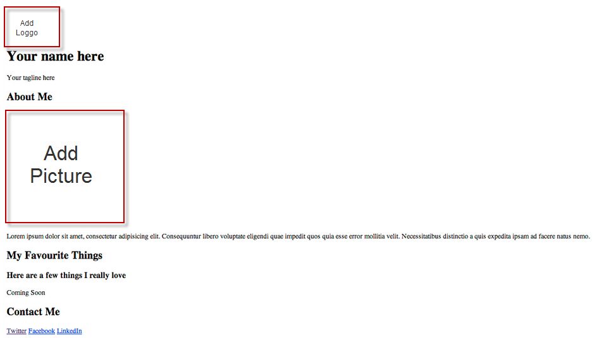

Slide 12
A quick note about image types:
Hint: You'll want to use <h1> and </h1> once, <h2> and </h2> three times and <h3> and </h3> once.
Hint: Images
<img src="logo.png">
There are three main image types: jpg, png and gif. Here's a general rule of thumb:
Using a large image or photograph: choose jpg
For icons, logos, text or anything that requires transparency: choose png
For animations, especially of cats: choose gif (this is a joke)

Slide 13
CSS is closely paired with HTML
CSS doesn't do anything on its own, it's the presentation layer on top of a content base
If HTML is the beams of the house, CSS is the layout, paint, and decorations

Slide 14
CSS Syntax
CSS is made up of rules that refer to HTML elements (like <p> and <ul>), and define what those elements should look like.
A CSS rule is made up of a selector and one or more declarations
A selector tells the browser what element(s) we are styling.
It looks like this:
h2 {}
The above selector will select all <h2> elements and apply our styles to them. Our styles will go between the curly brackets.

Slide 15
CSS Syntax
A declaration tells the browser what style we want to apply to our element
A declaration is always made up of two parts: a property and a value
A property tells the browser what we are modifying (ex. font, colour, size)
A value tells the browser how to modify the property (ex. Arial, green, small)
A declaration looks like this:
background-color: green;

Slide 16
CSS Syntax
background-color: green;
The value (the part after the colon) is specific to the property type
Ex. size-related properties like height, width, or font-size are usually specified in px (pixels), while colour-related properties are specified with a colour name or code
It's very important that you write the syntax correctly, with a colon after the property name and a semi-colon after the value.

Slide 17
Adding CSS to HTML
You write CSS rules in a set of <style></style> tags
You add the style tags to the <head> of your HTML document like this:
<html>
<head>
<style>
h2 {
background-color: green;
}
</style>
</head>
<body>
</body>
</html>

Slide 18
CSS Syntax
Adding CSS to HTML
When we put selectors and declarations together, they make a CSS rule, which looks like this:
h2 {
background-color: green;
}
This rule will select all <h2> elements and change their background colour to green.
Try copying and pasting the above code in between the <style> tags and refreshing the page in your browser.

Slide 19
CSS Syntax
We can add multiple declarations (property: value; sets) to one selector to modify multiple properties:
h2 {
background-color: green;
font-size: 28px;
}
Make sure you always end each declaration with a semi-colon
Try replacing the previous rule for <h2> with this one and refreshing your browser
Next, clear out all the code you added between the <style> tags. We're adding more soon!

Slide 20
Using Hex Codes
Let's change the text to a colour that's easier to read.
We're going to use a hex code, which is a 6-character code that specifies a colour.
You don't have to understand how they work, just remember that they start with a # sign. It might help you to know the Hex codes for some of the basic colours:
White: #FFFFFF
Black: #000000
Red: #FF0000
Green: #00FF00
Blue: #0000FF
The code for a nice dark grey is #444444. Let's add it.
body {
color: #444444;
}
Check outhttp://colorpicker.com for more awesome colours!

Slide 21
Styling Type with CSS
There are lots of CSS properties which let us style the text in our HTML:
font-size
font-weight
font-style
font-family
color
line-height

Slide 22
Styling Type with CSS, Part 2
Let's change the font to a sans-serif like Helvetica:
body {
color: #444444;
font-family: Helvetica, Arial, sans-serif;
}
The font-family property accepts a list of font names: the first font is your first-choice font, the next ones are fallbacks in case that font is not available. Not all fonts are commonly available, so try to stick to 'web-safe' fonts like:
Arial
Verdana
Times New Roman
Georgia
Courier

Slide 23
Changing Font Size and Line Height
If we want to make our <h1> and <h2> tags a bit bigger:
h1 {
font-size: 48px;
}
h2 {
font-size: 32px;
}
We can change the line height (or leading) with the line-height property to make it easier to read
line-height is specified as a multiple of the size of the font: so a value of 1.4 means the lines will be 1.4x as tall as the text.
p {
line-height: 1.4;
}

Slide 24
Styling Images
Let's add a dark border around the profile image. Start by writing a selector to pick out the <img> tag.
img {}
The border property has 3 parts: the width, the style, and the colour. So, if we want a 1px wide, solid, grey border, we use:
img {
border: 1px solid grey;
}
Being More Specific
Our border is now applying to all images on the page, including our logo. We don't want that, so we need a way to target only the profile image.
HTML gives us a way to attach extra identifying information to HTML elements so that we can target them. We call these "classes".
Classes are attributes that you add on to tags.
<p class="classname"></p>

Slide 25
Targeting an Element with a Class
We can write a selector in our css to target the element we added a class to using a .
p.classname {}
And then apply the styles we want to only the item with the class:
p.classname {
color: red;
}

Slide 26
Exercise: Style Profile Image
Add some style to your profile image!
Add a class of profile to the tag for your profile image
Target that class in your CSS with the selector img.profile
Then add a border of any color you like
If your picture is too big, you can resize it using the width and height properties, which are specified in px (pixels). Try 200 x 200 px. An example of how to use width and height is below:
img {
width: 200px;
height: 200px;
}

Slide 27
Solution: Style Profile Image
Your HTML should look something like this:
<img class="profile" src="images/profile.jpg">
And your CSS should look something like this:
img.profile {
border: 1px solid grey;
width: 200px;
height:200px;
}

Slide 28
Adding More Classes
We can do the same thing to style our "favourite things" images.
Since we probably want all four images to have the same styles, we can add the same class to each.
Add a class of "favourite" to each of the four images.
<img class="favourite" src="images/kitten.jpg" >
Add some styles to your images, using things like width, height, and border.

Slide 29
More Stuff You Can Do
Try something fun like border-radius: 50%;
Or border: 3px dotted pink;
Or even box-shadow: 0 0 4px grey;
Your CSS might look something like this:
img.favourite {
border: 1px solid grey;
width: 200px;
height: 200px;
border-radius: 50%;
}

Slide 30
The Box Model
This is the trickiest part of CSS, don't worry if it seems confusing at first!
The CSS "Box Model" describes the way CSS styles the size and spacing of HTML elements.
To understand the box model, we need to understand how the browser "sees" HTML elements.
To the browser, every HTML element is a rectangular box.
If we show the outlines of all the elements in an HTML document, it looks a bit like the next slide:

Slide 31
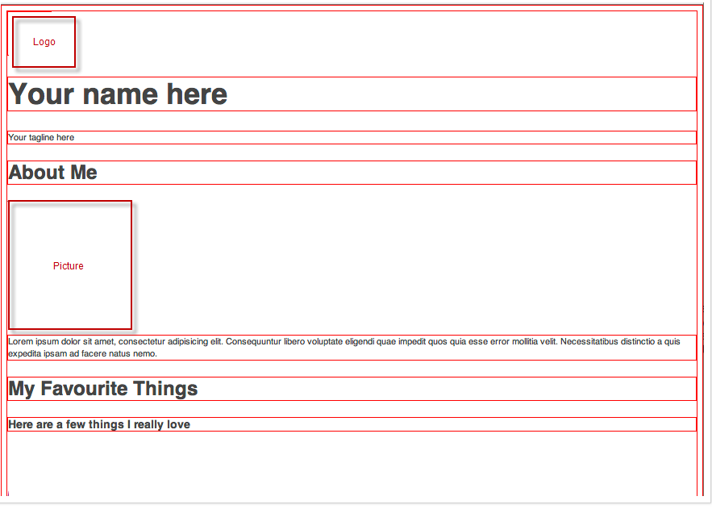
Example to what we did HTML in box model

Slide 32
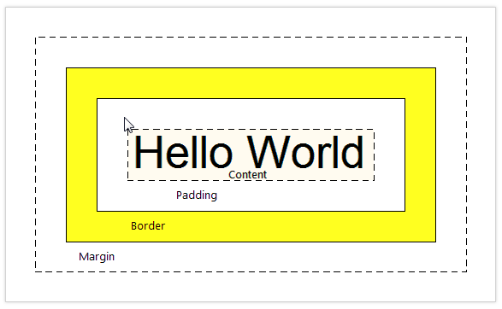
The Box Model
CSS uses 5 properties to determine the size and spacing of these boxes:
Margin, padding, border, width, and height
These 5 properties make up the Box Model

Slide 33
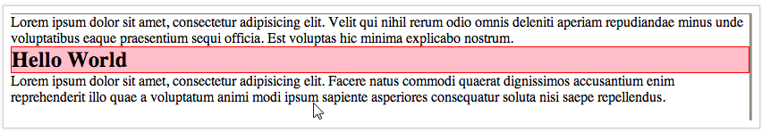
Margin and Padding
Let's say we have 3 elements in our HTML document: a <p>, an <h2>, and another <p>
Let's put a red border around the <h2> and add a pink background:
h2 {
border: 1px solid red;
background: pink;
}
So far, this looks pretty awfull. All the elements are too close to each other!

Slide 34
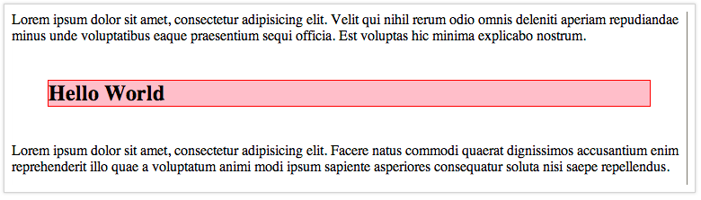
Margins
There are two CSS properties for adding space around our elements: margin, and padding
The margin property adds space around the element, outside of the border:
h2 {
margin: 40px;
}
This code adds 40px of space on every side of the element.

Slide 35
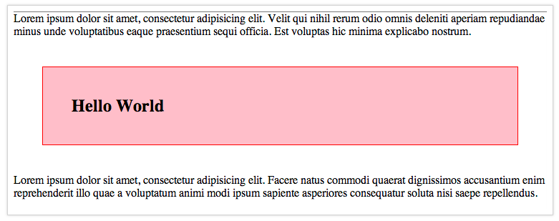
Padding
If we want to add some space inside the border, we use the padding property:
h2 {
margin: 40px;
padding: 40px;
}
This code adds 40px of space to every side of the element, but it does so within the border.

Slide 36
Margin vs. Padding
Adding padding to an element makes the element bigger, whereas adding a margin adds space around the element.
If you make a 100px wide element, and then add 40px of padding to it, it will become 180px wide.
If you add a 40px margin to a 100px wide element, it stays 100px wide.
If you add a 1px border to a 100px wide element, it will become 102px wide.
If your element doesn't have a border or a background, you may not be able to see the difference between margin and padding.

Slide 37
More on Margins and Padding
You can specify which side of an element you want your margins to apply to with the margin-top, margin-right, margin-bottom, and margin-left properties:
h2 {
margin-top: 40px;
margin-bottom: 40px;
}
The same goes for padding and border:
h2 {
padding-bottom: 40px;
border-left: 1px solid red;
}

Slide 38
Exercise: Box Model
Add some padding to your profile image. This should create space between the image and the border around it. Try about 5px.
Add both padding and a margin to your 'favourite things' images. Try 5px for the padding and about 10px for the margin.

Slide 39
Solution: Box Model
Your code should look something like this:
img.profile {
padding: 5px;
}
img.favourite {
padding: 5px;
margin: 10px;
}

